Slide 1
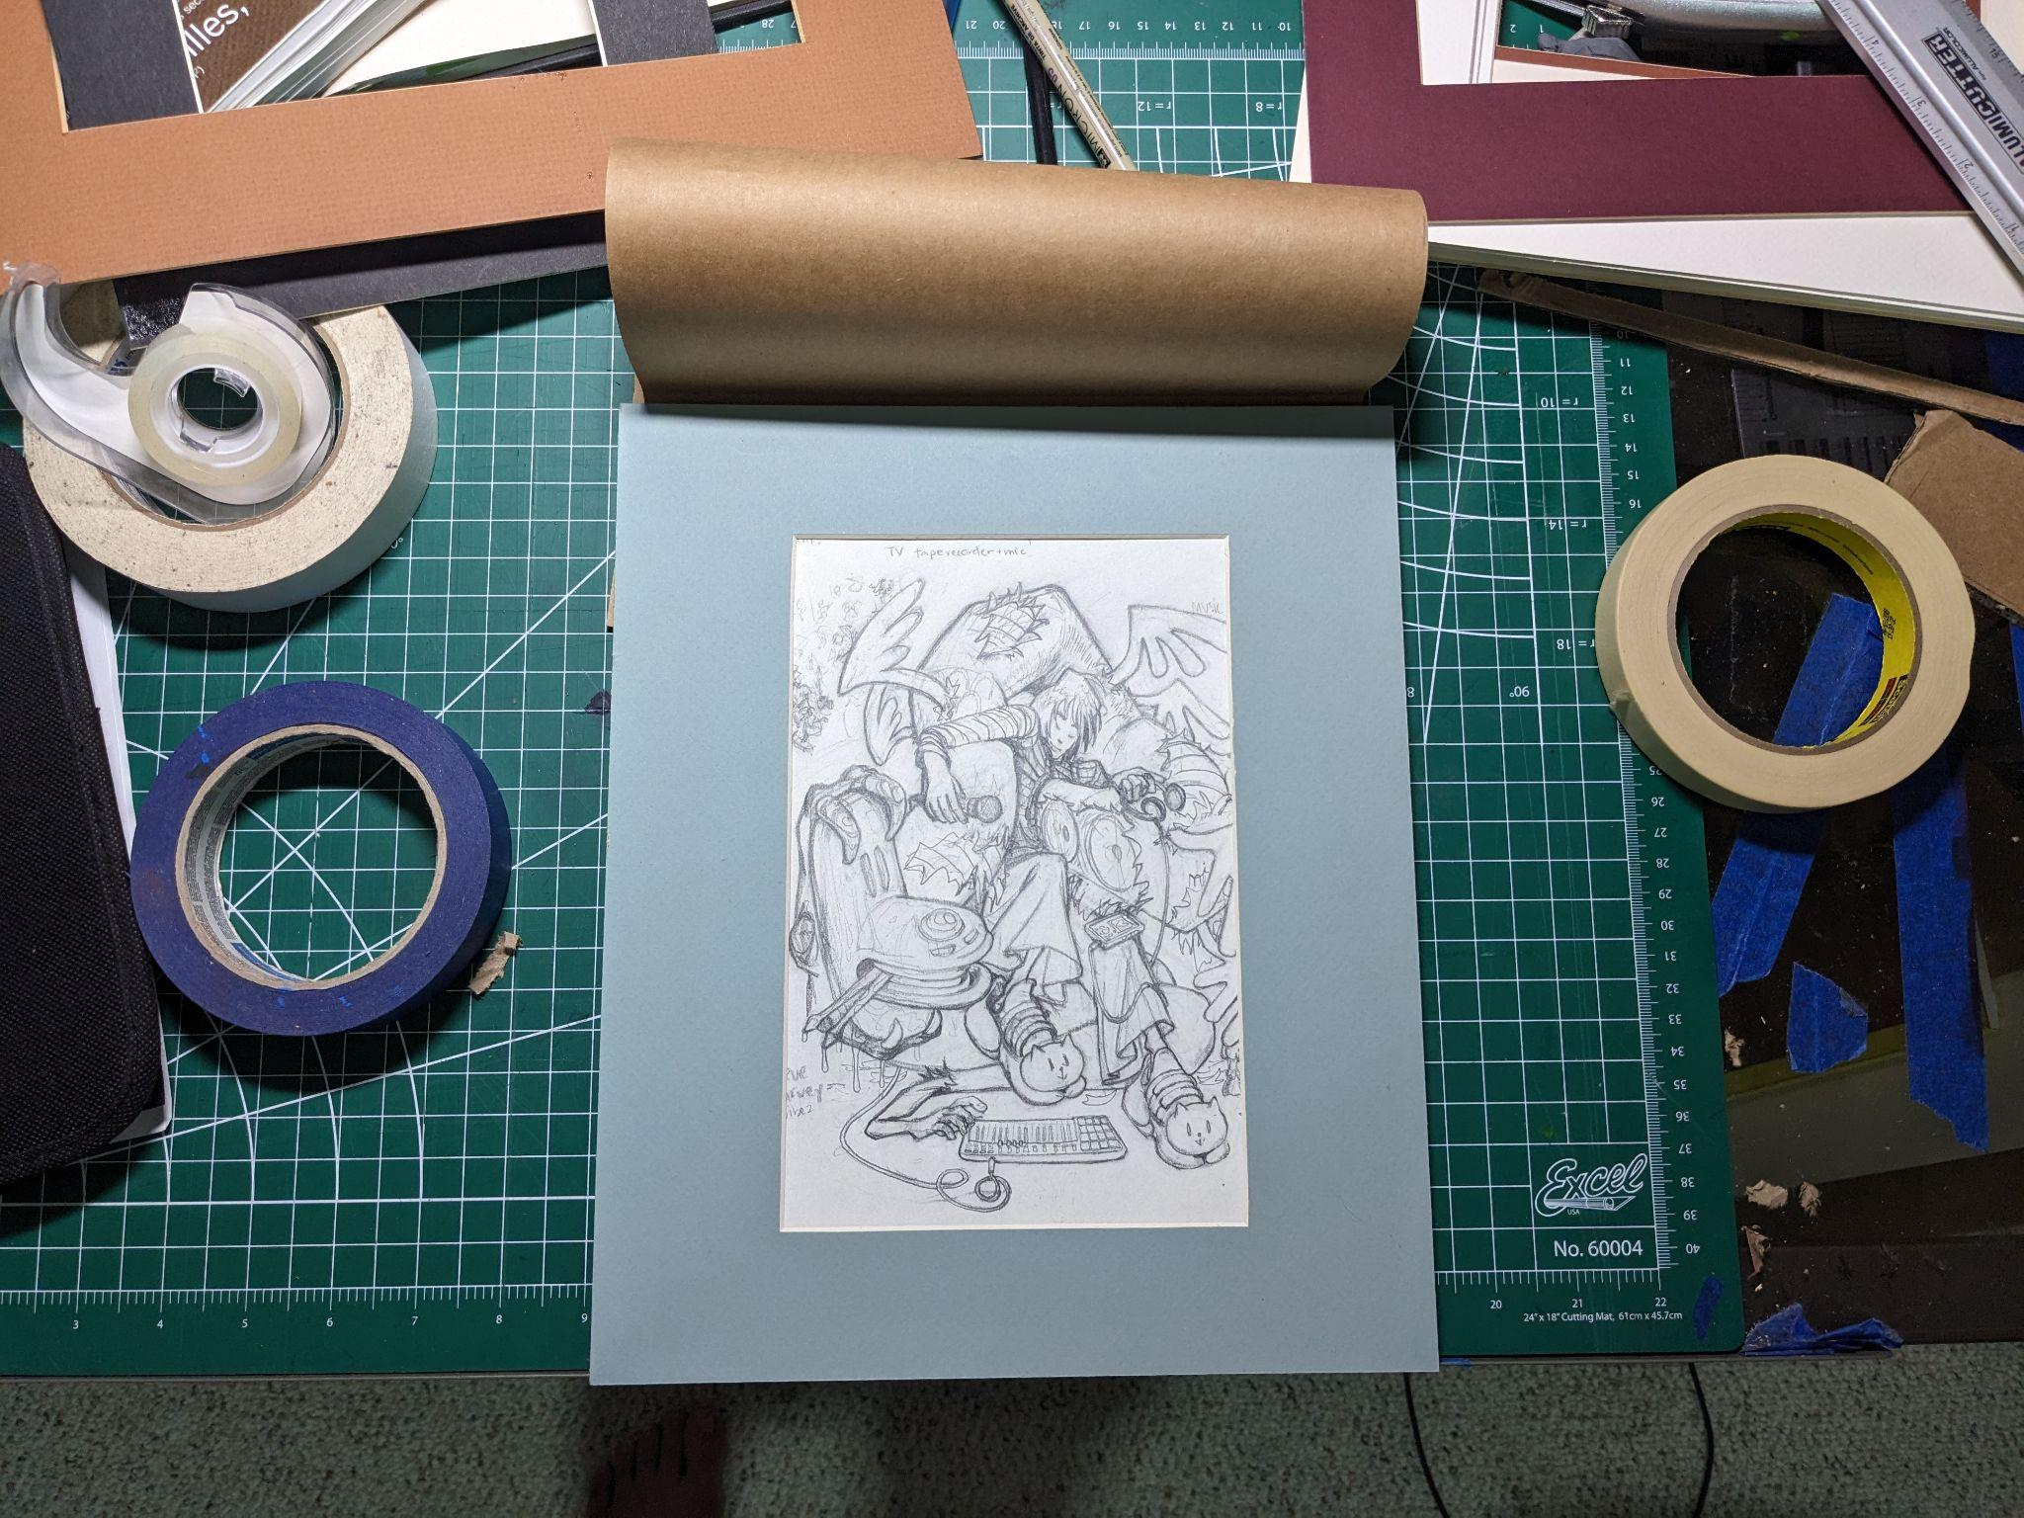
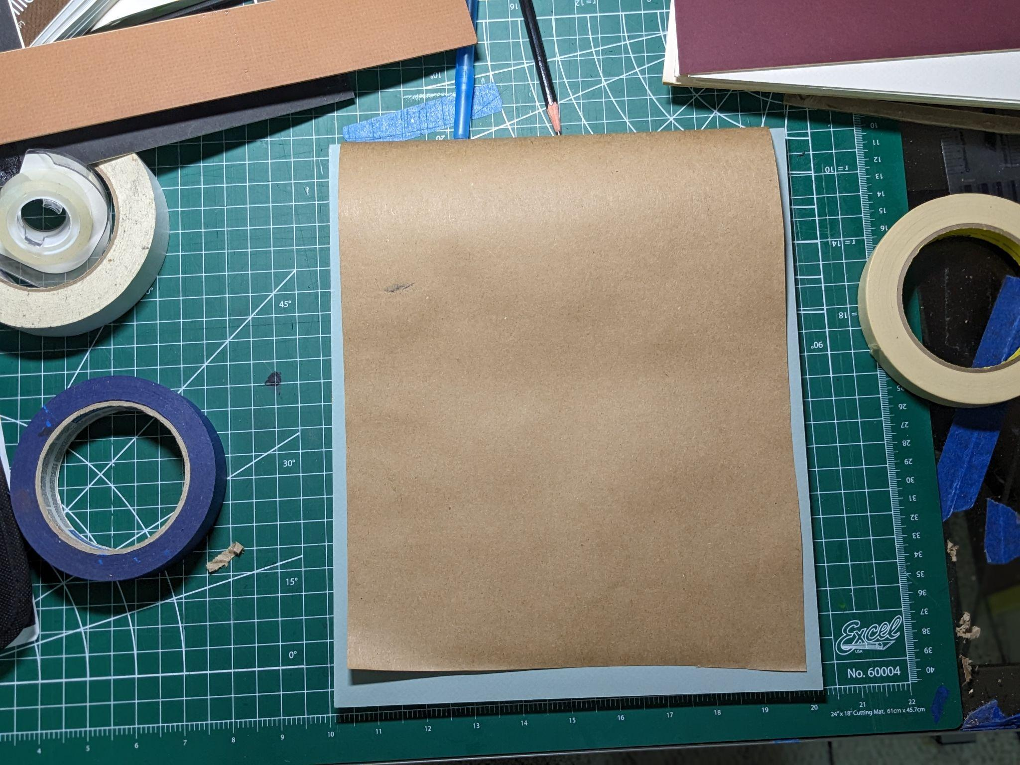
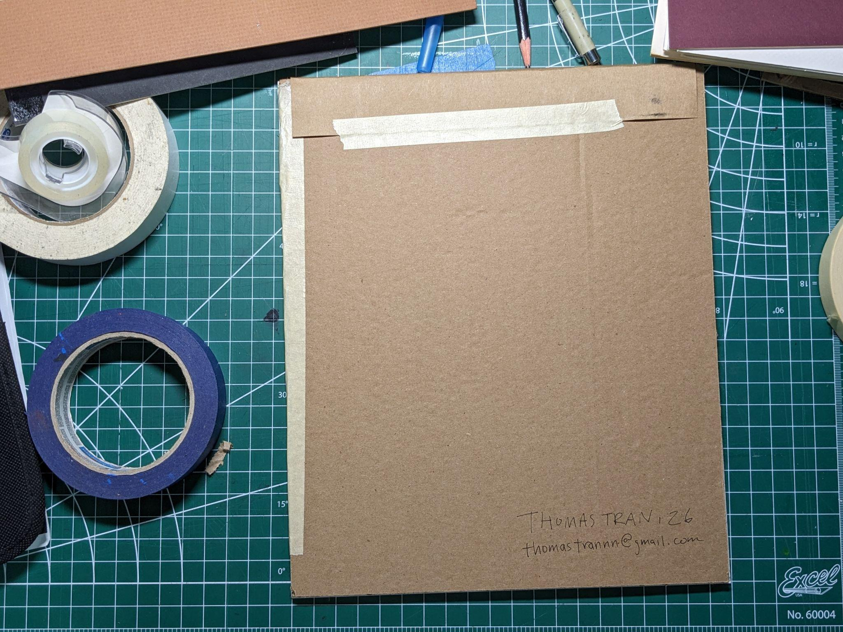
How to Prepare Your Art for the Art Show at the
Viet Cultural Fest!
front
front
back

Slide 2
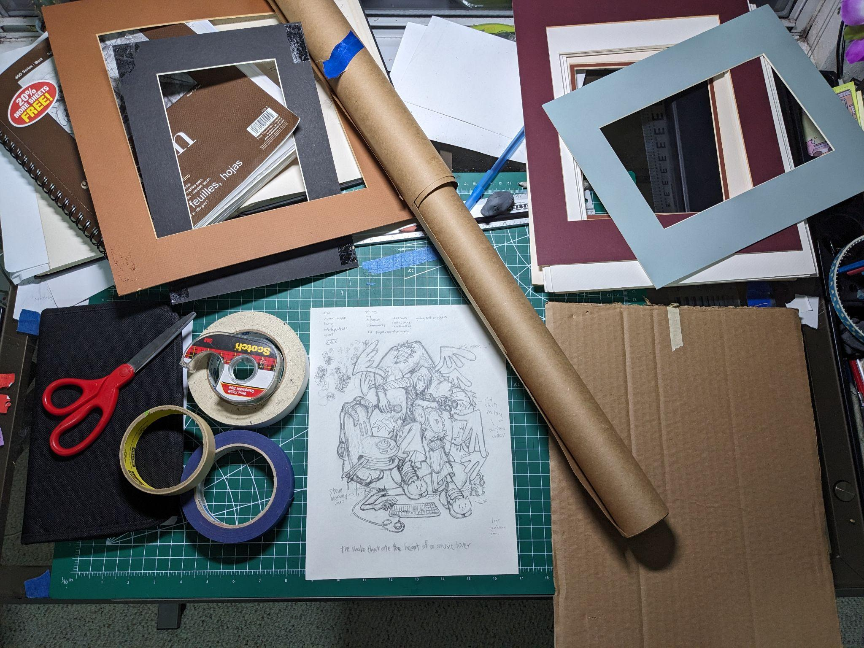
For 2D Art:
Materials:
Your 2D art
Mat (usually inside most framed art. You can find at an art supply store like Michaels.)
Stocky backing like cardboard or poster board.
Kraft paper or any light paper, i.e. wrapping paper, printer paper.
Painter’s tape or masking tape. (or any low-adhesive tape)
Scissors
X-acto knife
Ruler/hard edge to run x-acto knife on
* paintings on stretched canvas do not need to apply mat, but do need to attach cover slip and have your info on the back (step 6-8)
*dry media (graphite/pastel/etc.) need to be spray fixed to prevent smudging.

Slide 3
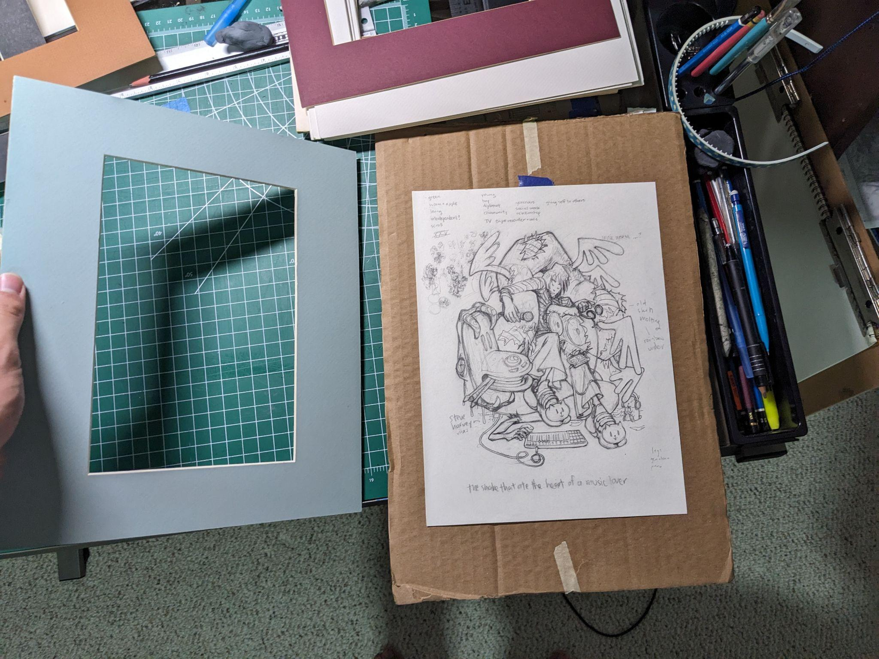
1. Tape your art to the back of the mat. Take your time to align your art with the mat.

Slide 4
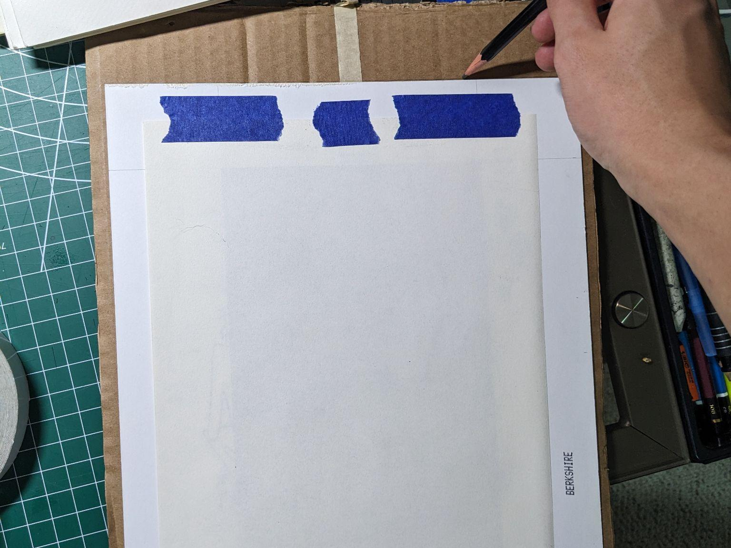
2. Secure art to mat with more tape.
3. Create outline on your stocky backing using the mat.

Slide 5
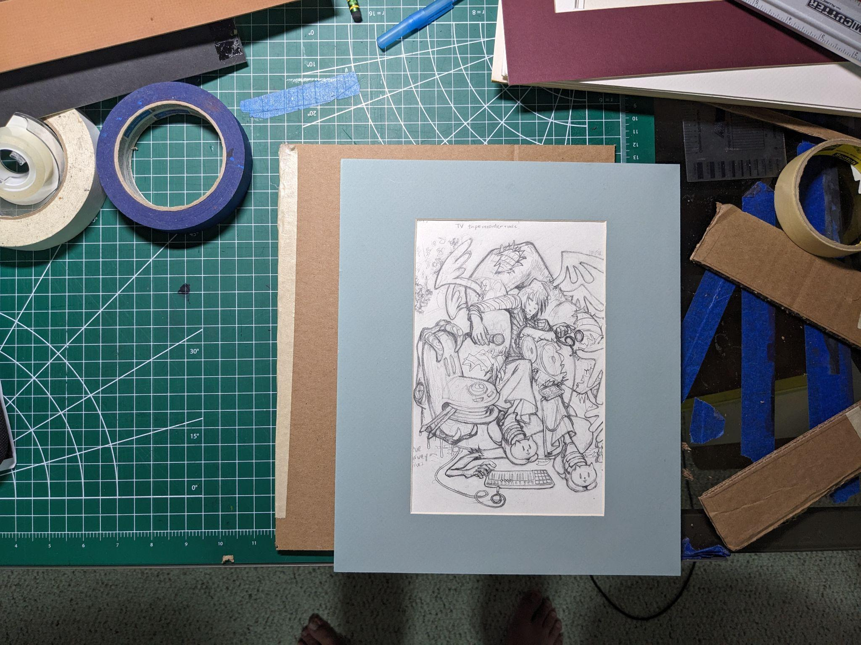
4. Cut stocky backing slightly smaller than the outline you made. I used an x-acto knife and ruler to do this. You can do this with scissors too. This makes it so the backing does not show when the piece is hanged and provides some protection.

Slide 6
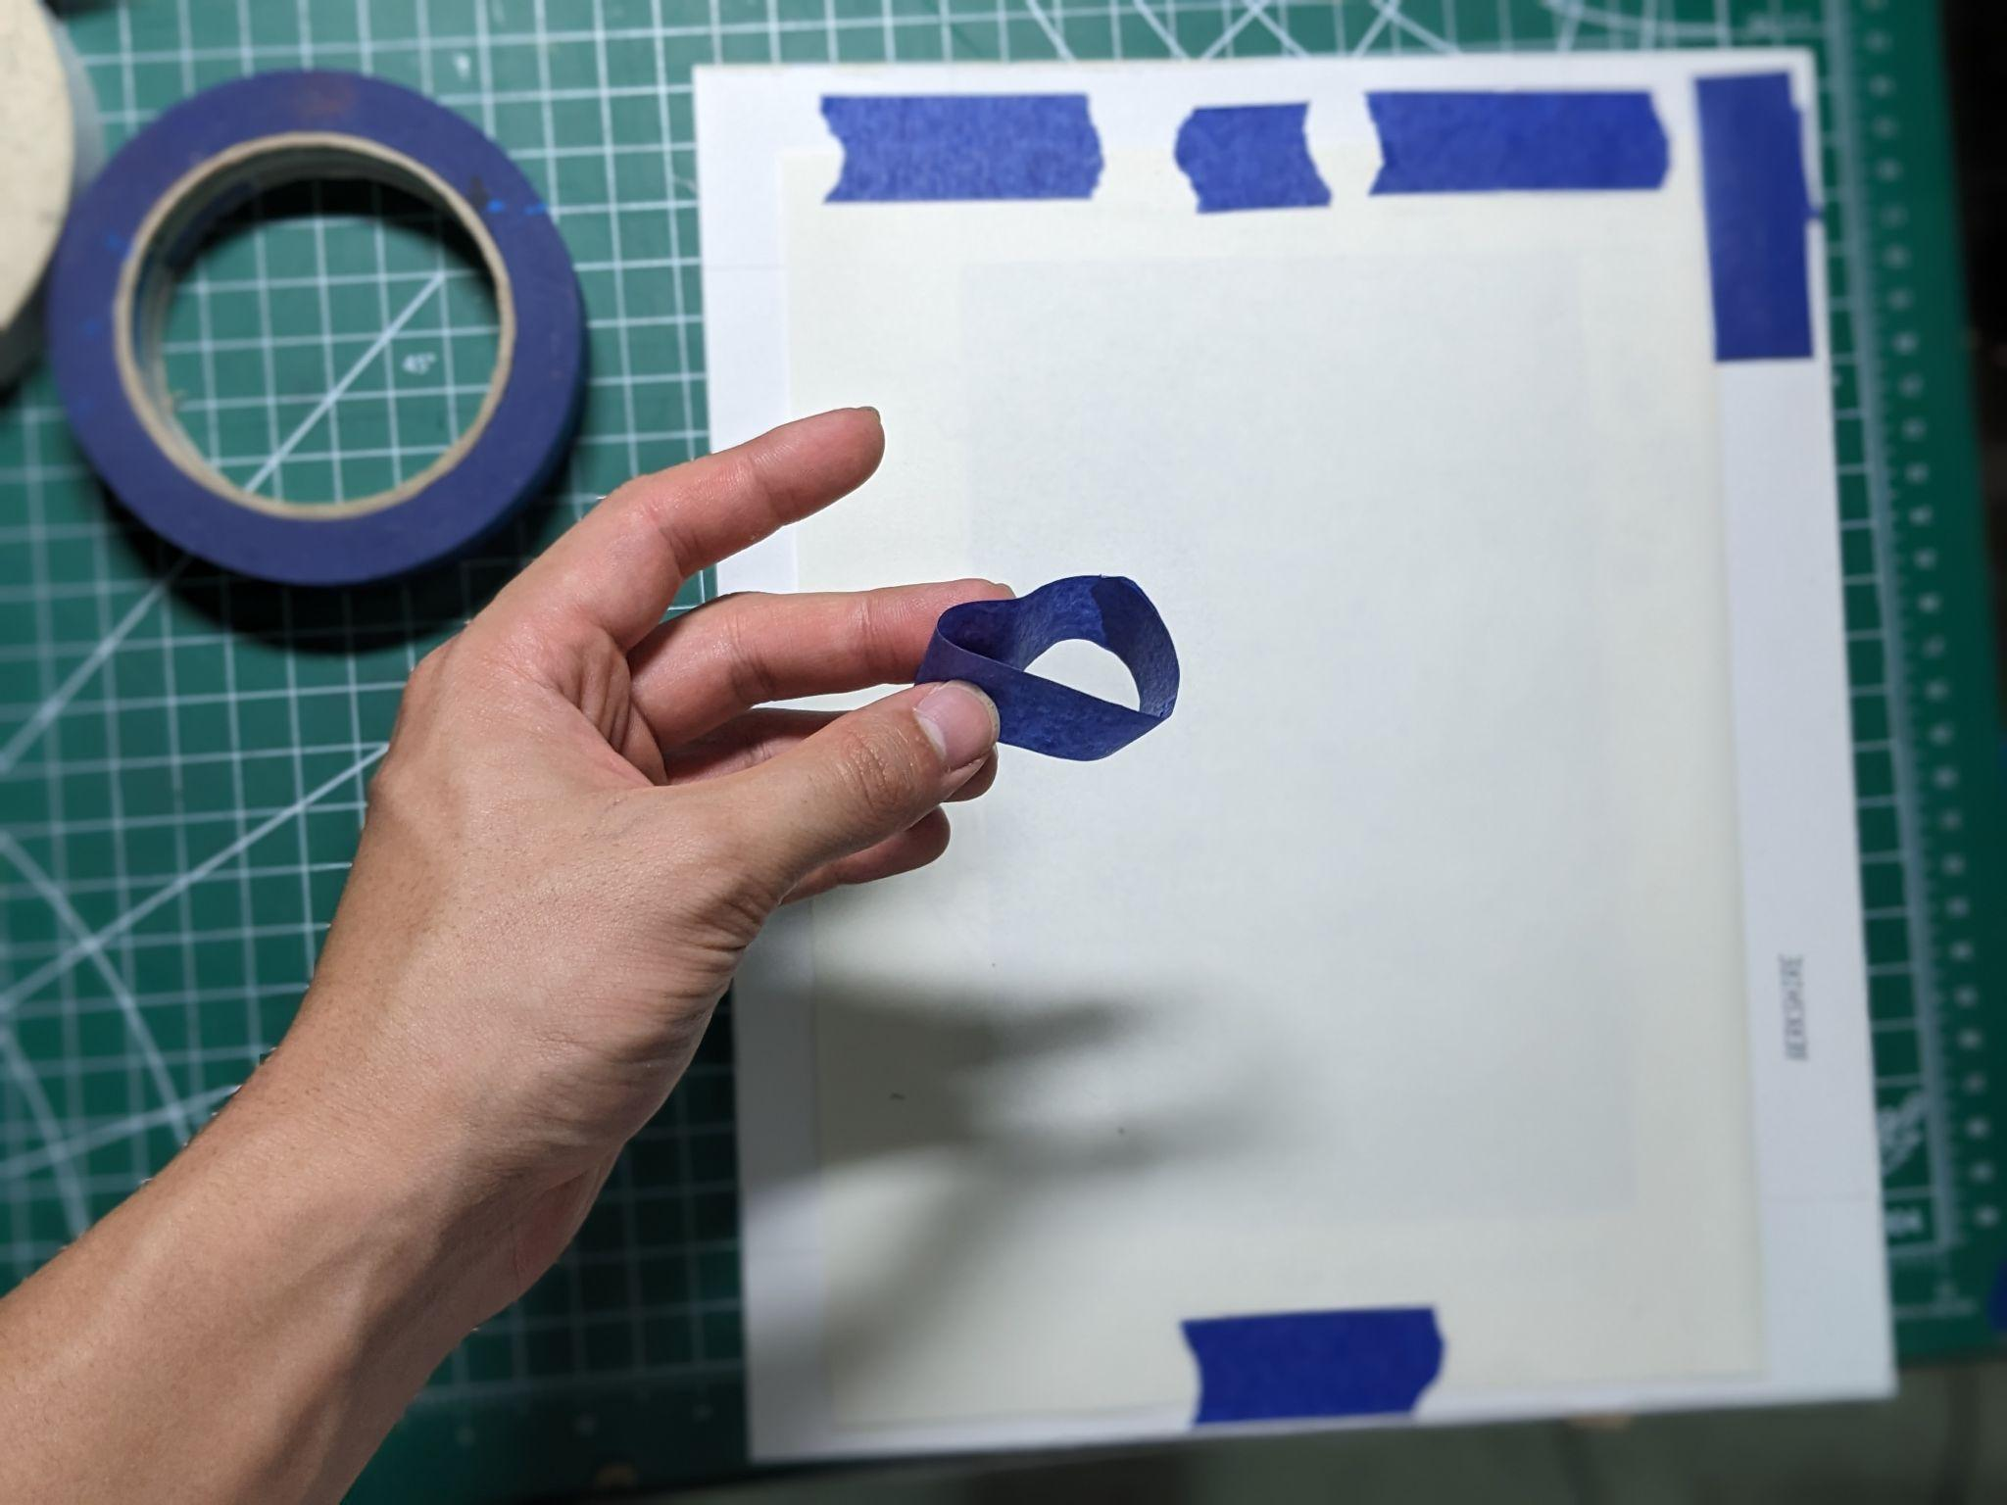
5. Flip mat & art over and apply double sided tape. Alternatively,make rings with your tape and then attach the stocky backing to mat & art.

Slide 7
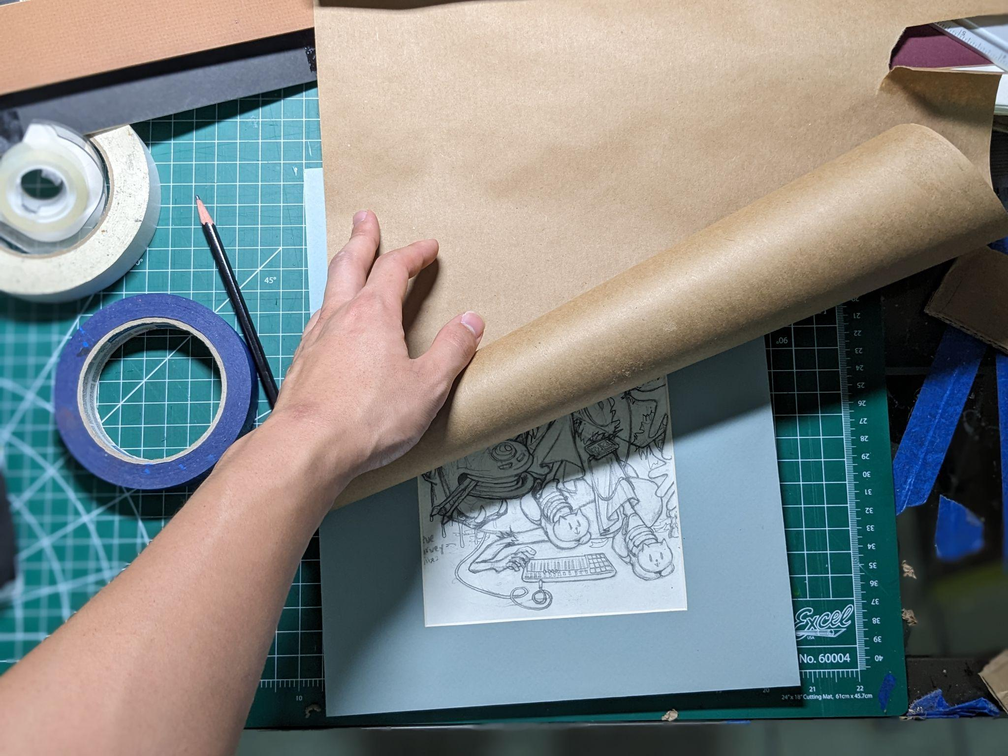
6. Measure/Approximate enough kraft paper to cover your art and enough extra on top to tape the kraft paper to the back on the stocky backing.
This does not need to be perfect. This paper is only needed to protect your art during transport.

Slide 8
7. Tape the kraft paper to the back.
8. Put your name, age, and email/phone number on the back.

Slide 9
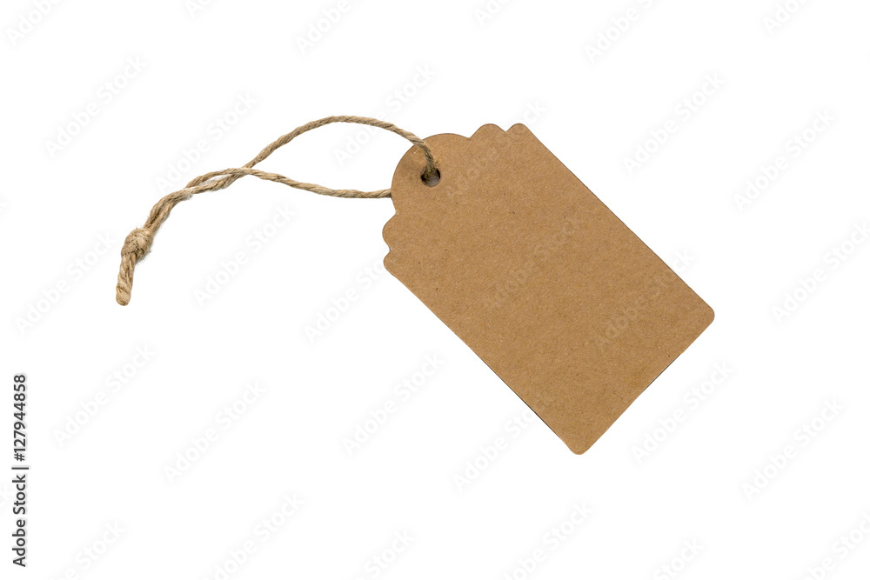
For 3D Art:
Attach a tag to your piece with your name, age, and email on it.
Tag does not need to be exactly like the one in the image. We just need your name, age, and contact information attached to your piece.
*All 3D art submissions must be in a box (for transport).

Slide 10
Great job!
Now you are ready to submit!
Any questions please email us at:
art@vcsa.org
For mail-In submissions, please package your art with plenty of filler paper/bubble wrap, packaging materials to fully protect the artwork.
We will use the same packaging to return your work to you!

